Slide 1
Car Damage Detection
Diljyot Singh

Slide 2
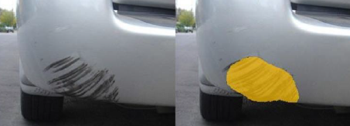
Introduction
In recent years, the advancement of computer vision techniques, particularly deep learning algorithms, has revolutionized various fields, including automotive safety and insurance assessment.
This project proposes the implementation of Mask R-CNN (Region-based Convolutional Neural Network) for the detection and segmentation of car damages in images.
The objective is to develop an efficient and accurate system capable of automatically identifying and delineating different types of damages such as scratches, dents, and cracks on car surfaces.

Slide 3
Data Collection
64 Car damage Images were extracted from the internet for training, validation and testing.
49 images were used for training and 15 were kept for validation/testing.
For annotating the images, 2 tools were used:
LabelBox for Mask RCNN
Roboflow for YOLO (You only look once)

Slide 4
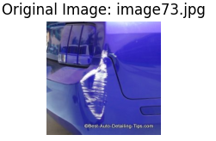
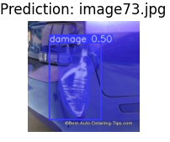
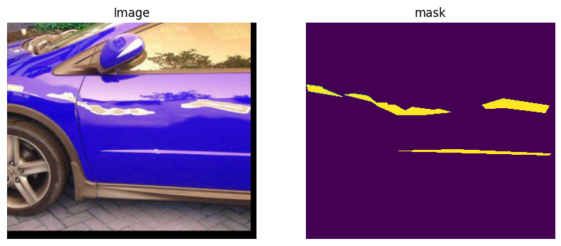
Methodology
To detect and segment the car damage on the images we are going to use Mask RCNN and a YOLO instance segmentation model.
To achieve instance segmentation, we need to address two sub-problems.
Object Detection
Semantic Segmentation

Slide 5
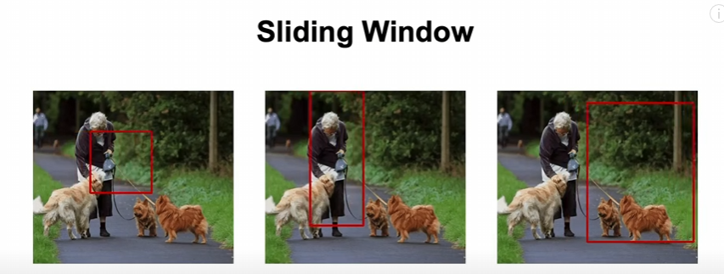
Architecture – Object Detection
Sliding Window for object detection
With the sliding approach, the number of regions that we need to check using a CNN model is too high and not feasible

Slide 6
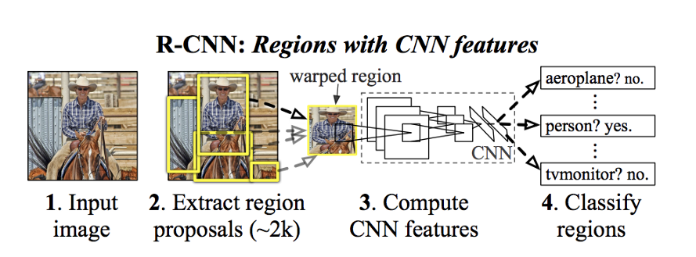
Architecture – Object Detection
RCNN (Region based Convolutional Neural Network)

Slide 7
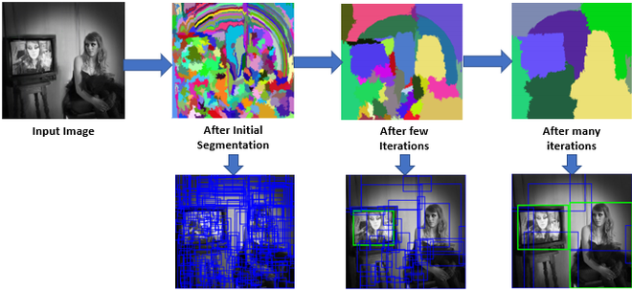
Architecture – Object Detection
Selective Search Algorithm for RCNN
Generate initial sub-segmentation of input image using the method "Efficient Graph-based Image segmentation"
Recursively combine the smaller region into larger ones. We use the greedy algorithm to combine similar regions to make larger regions. The algorithm follows the following steps -
From set of regions, choose two that are most similar.
Combine them into a single, larger region.
Repeat the above steps for multiple iterations
Similarity search consider 4 types of similarity when combing – Color, Texture, Size and Fill

Slide 8
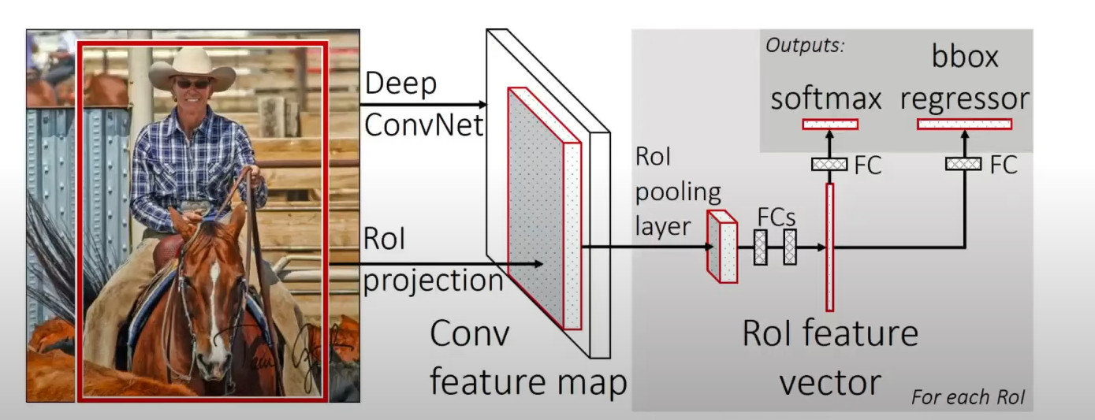
Architecture - Object Detection
Drawbacks of RCNN
Region Proposal method is not a learning algorithm.
Since, every region proposals are warped, the region proposals might lose its original features.
Can't be used for real time inference. Takes a long time to train.
Fast RCNN

Slide 9
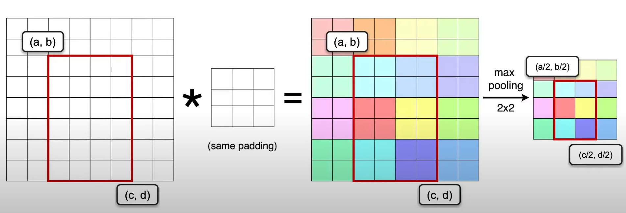
Architecture - Object Detection
ROI Projection
Run the region proposal algorithm on the input image and project the resulting region coordinates in the feature map

Slide 10
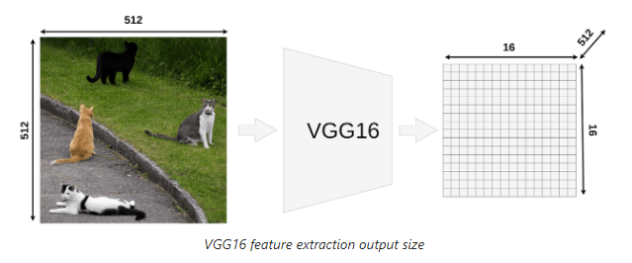
Architecture - Object Detection
Region of Interest (ROI) Pooling
For each ROI, we need to have a definite size for the fully connected layers.

Slide 11
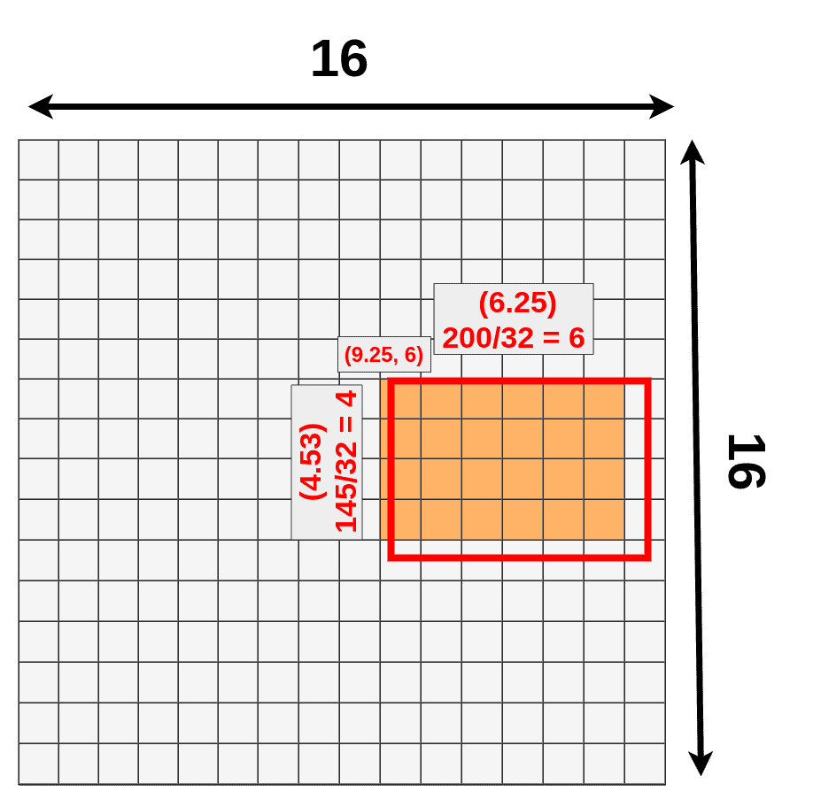
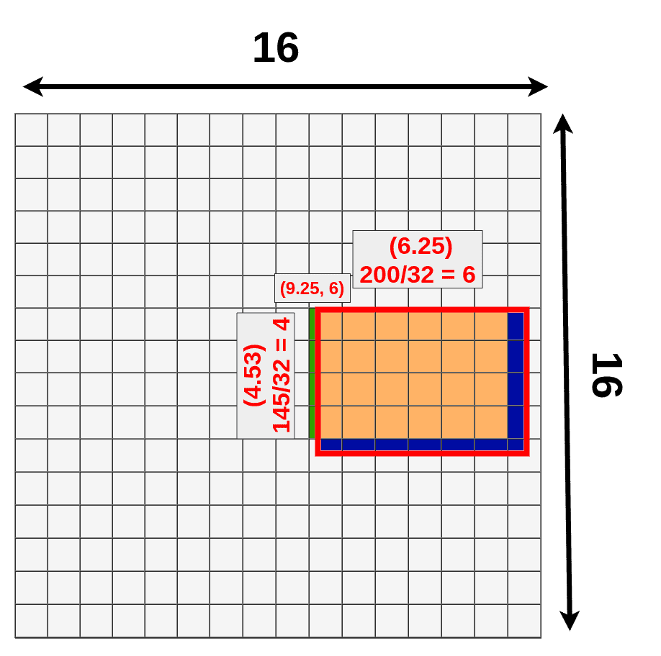
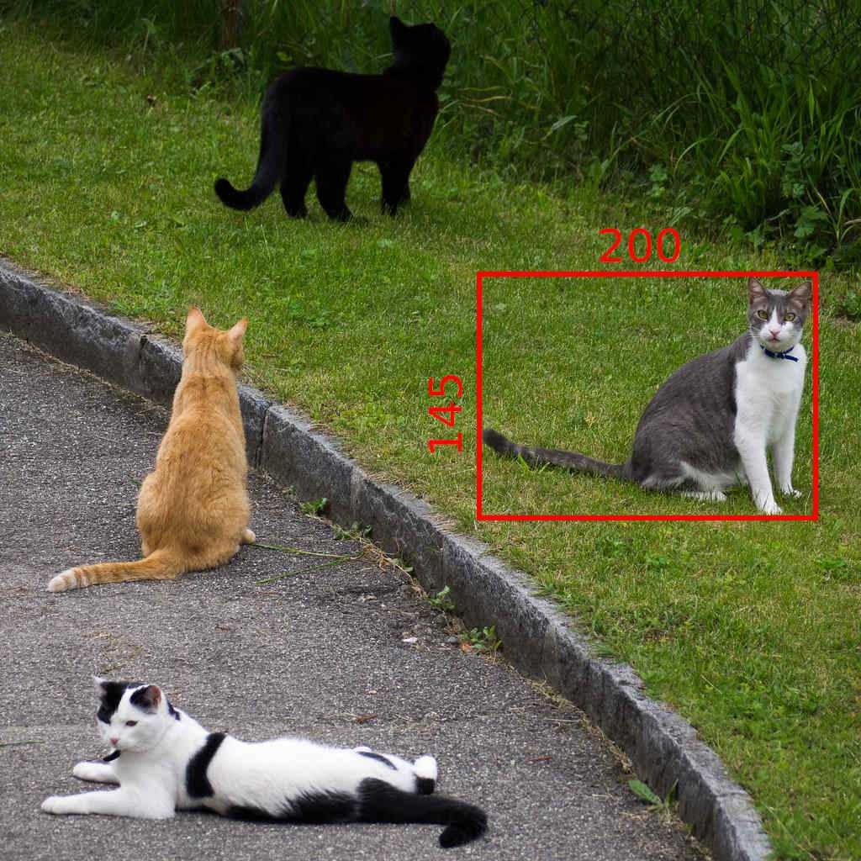
Architecture - Object Detection
Region of Interest (ROI) Pooling​
VGG
Quantization
16 X 32 = 512 pixels

Slide 12
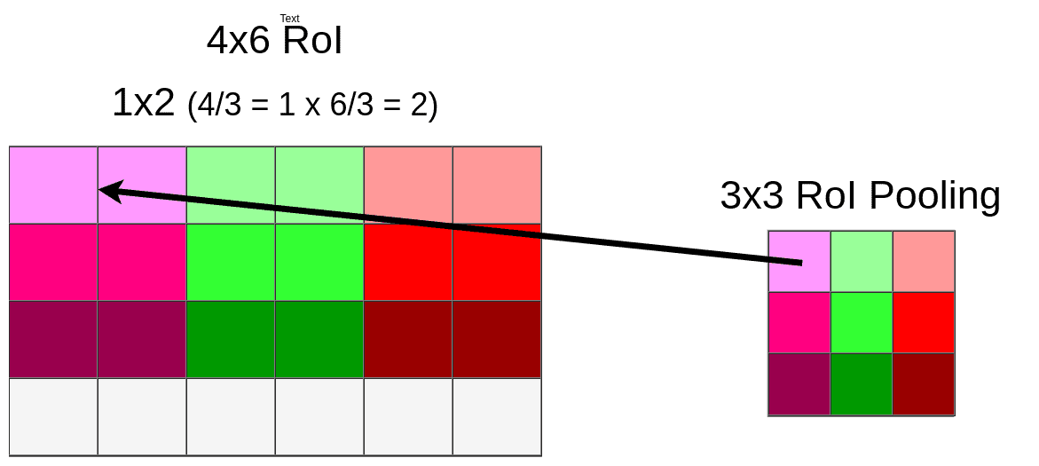
Architecture - Object Detection
Region of Interest (ROI) Pooling
For example, we are considering 3X3 feature vector for each region. In order to have a 3X3 feature vector we need to scale down each ROI into 3X3 using pooling.

Slide 13
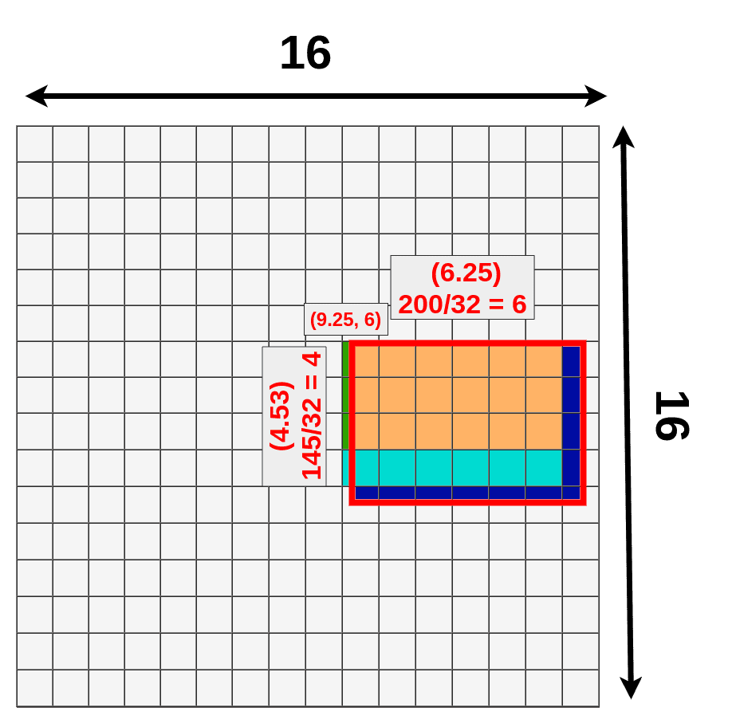
Architecture - Object Detection
Region of Interest (ROI) Pooling
Eventually, there is massive data loss with each ROI

Slide 14
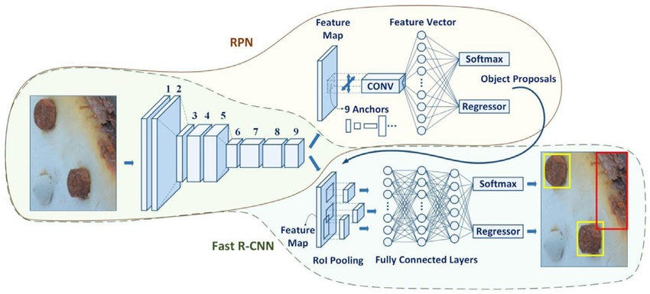
Architecture - Object Detection
Drawbacks of Fast RCNN
Huge Data Loss with ROI pooling
The Regional Proposal Algorithm (Selective Search) is an external algorithm that was not specifically tuned for object detection at hand.
Faster RCNN

Slide 15
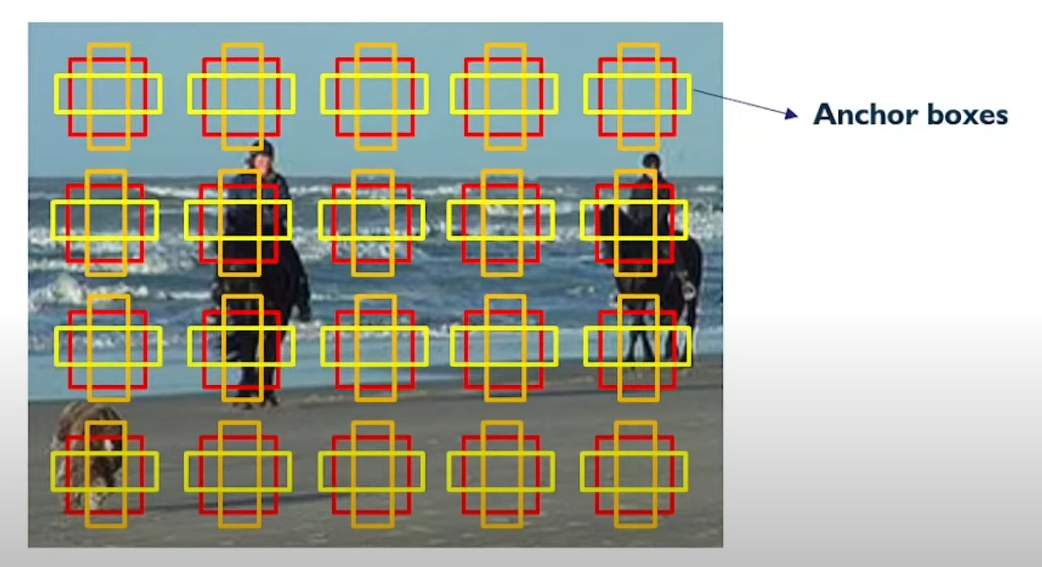
Architecture - Object Detection
Region Proposal Network
Anchor boxes: Anchor boxes are bounding boxes which are placed over the whole feature map and serve as locations at which the RPN is going to search for objects. Anchor boxes could be the initial proposal regions that converges towards desired proposal regions

Slide 16
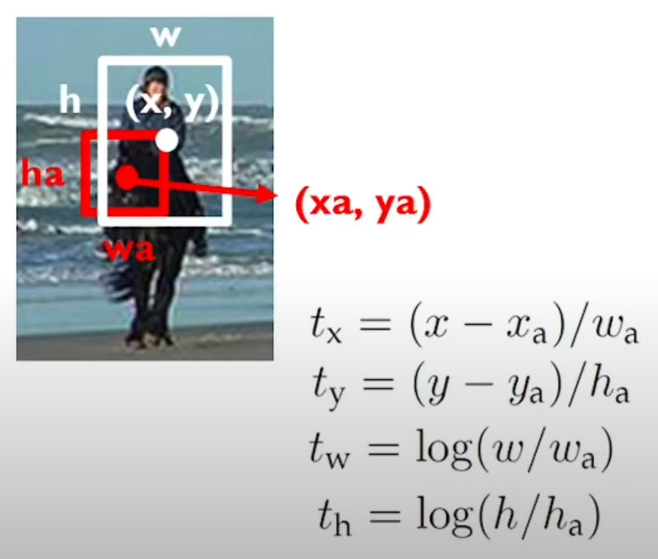
Architecture - Object Detection
Region Proposal Network
Region offset

Slide 17
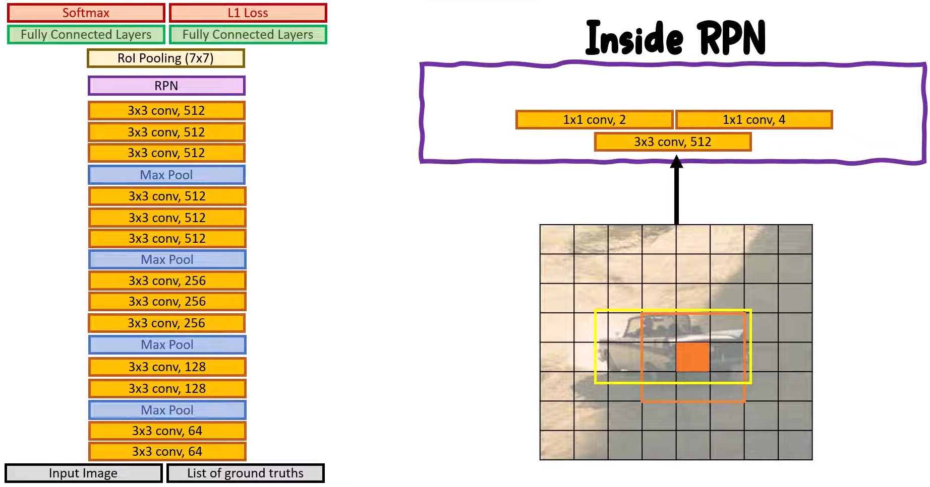
Architecture - Object Detection
Region Proposal Network

Slide 18
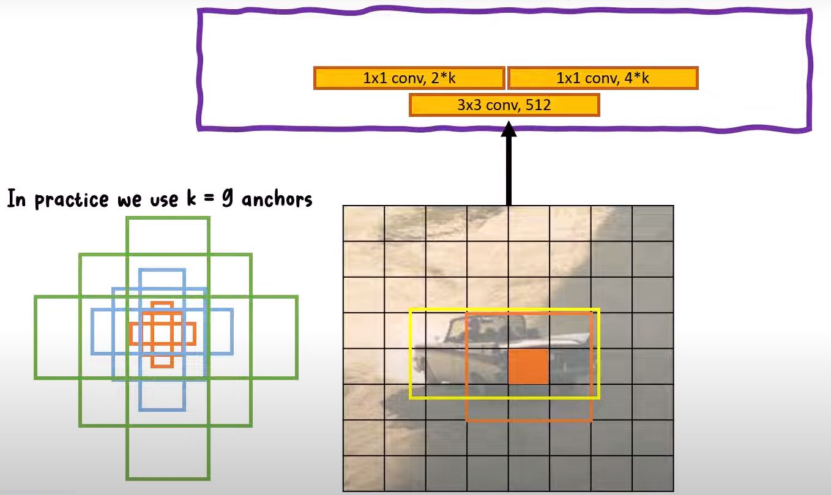
Architecture - Object Detection
Region Proposal Network

Slide 19
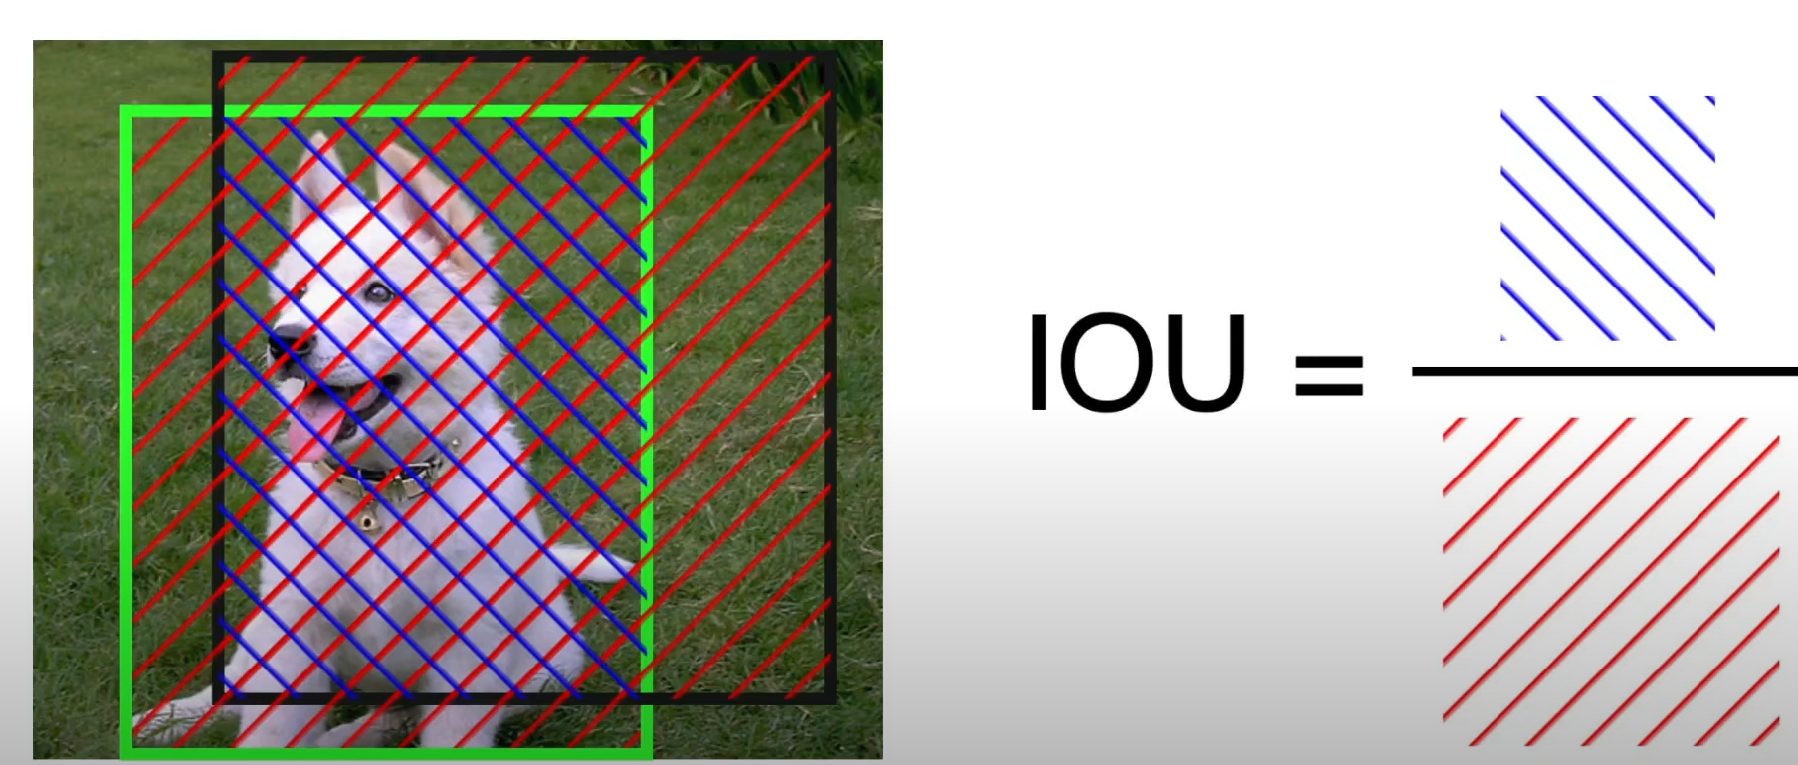
Architecture - Object Detection
Region Proposal Network
Intersection over union

Slide 20
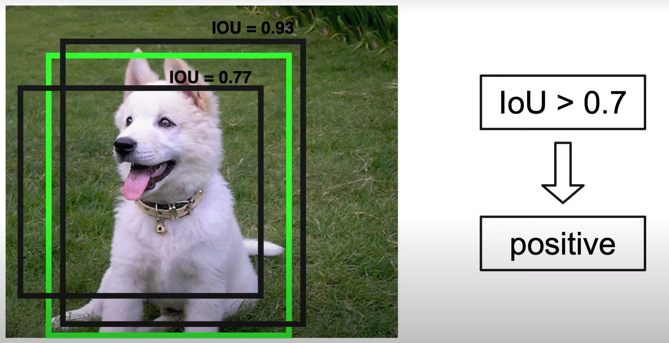
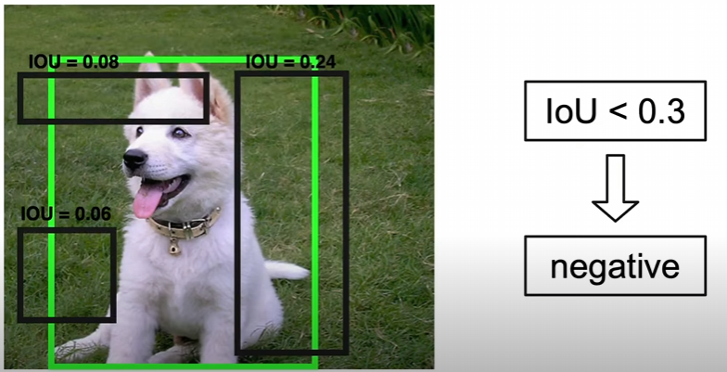
Architecture - Object Detection
Training - Region Proposal Network
We need to assign a binary label (object/ background) to each anchor.
A positive label is assigned to two kinds of anchors:
The anchors with the highest Intersection-over-Union (IOU) overlap with a ground-truth box
An anchor that has an overlap higher than 0.7 with any ground-truth box.
A negative label is assigned to a non-positive anchor if it's IOU is lower than 0.3 for all ground truth boxes
Anchors that are neither positive nor negative do not contribute to the training objective (0.3< IOU <0.5)

Slide 21
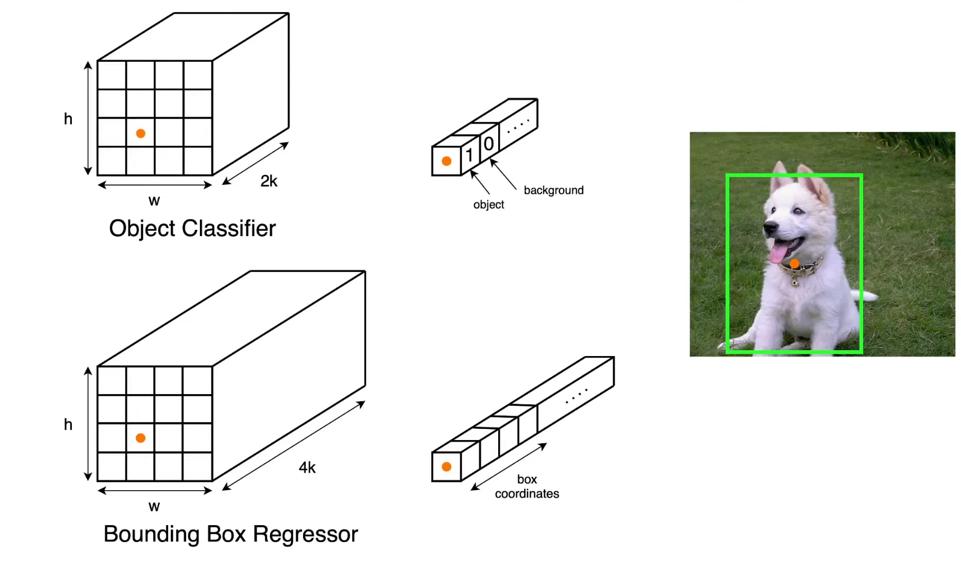
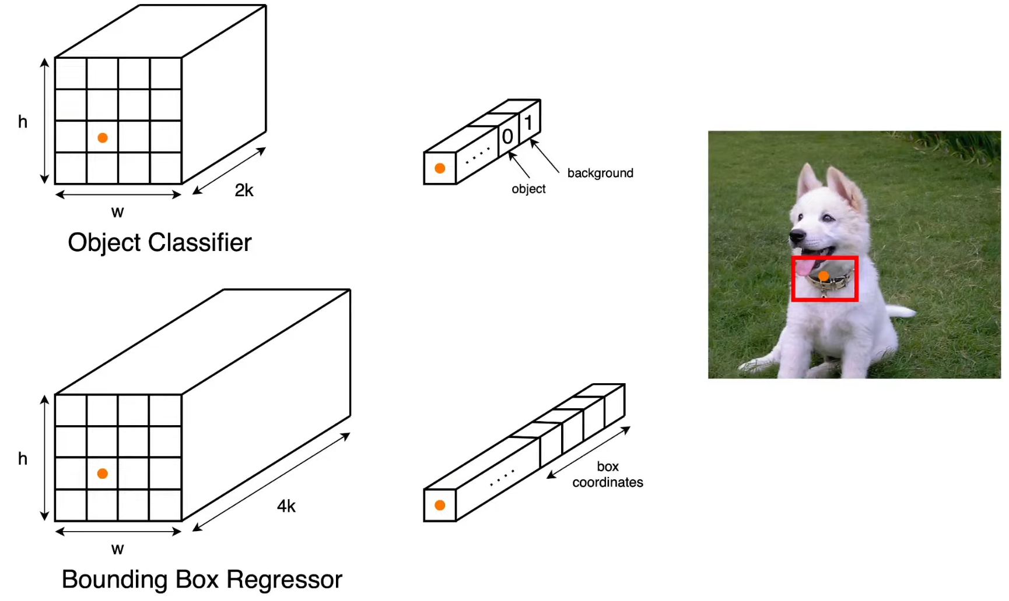
Architecture - Object Detection
Training - Region Proposal Network (Intuition)

Slide 22
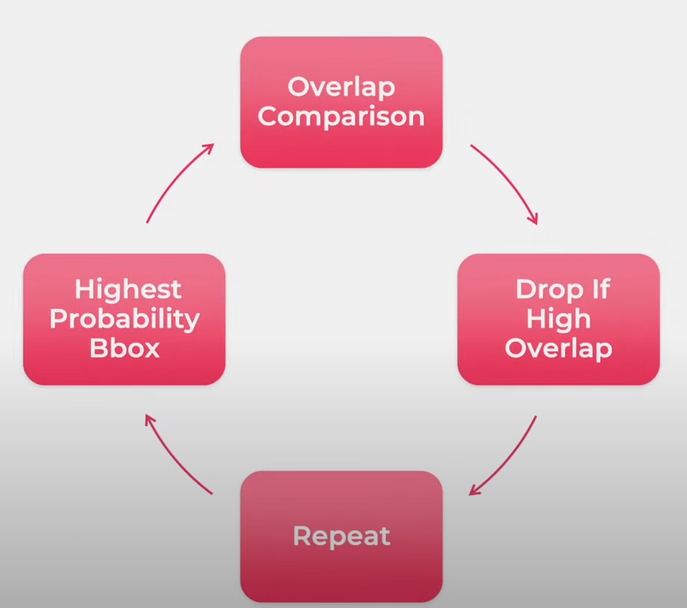
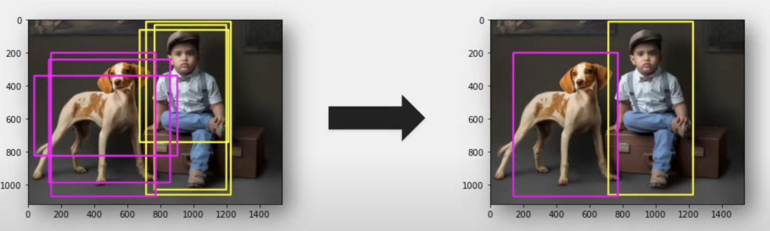
Architecture - Object Detection
Region Proposal Network
Non-max Suppression (Similar to similarity search)
Sort the bounding boxes with highest object probability score.
Calculate the IOU of all the bounding boxes with the bounding box having highest probability score.
Remove the smaller regions if the IOU is above certain threshold,
Repeat the cycle with the next highest probability score.

Slide 23
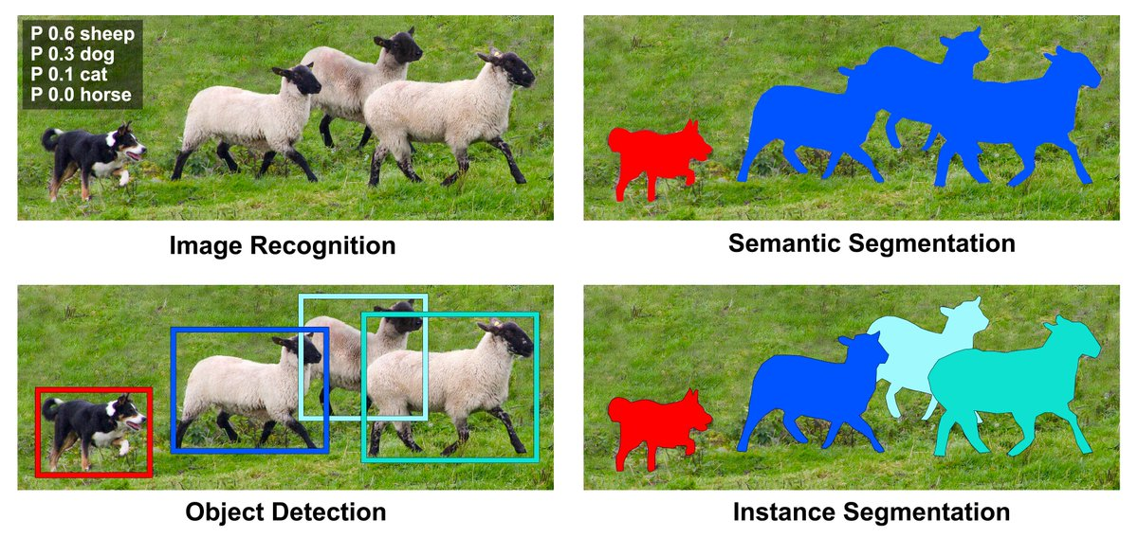
Instance Vs Semantic Segmentation

Slide 24
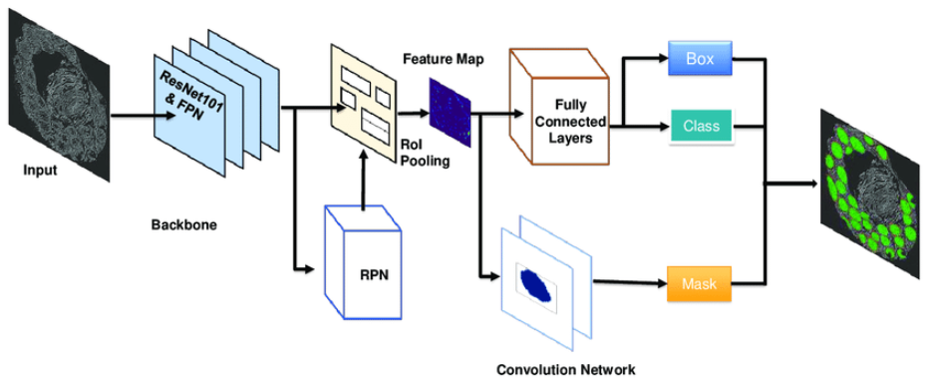
Architecture - Instance Segmentation
Mask RCNN

Slide 25
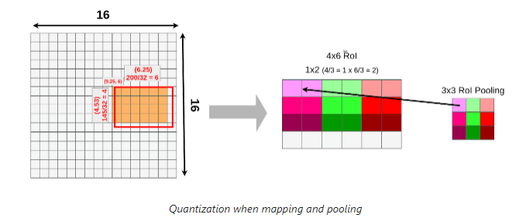
Architecture - Instance Segmentation
ROI Pooling (Recap)

Slide 26
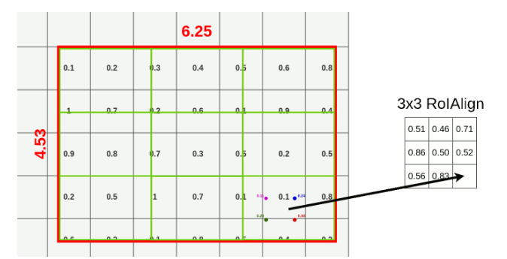
Architecture - Instance Segmentation
ROI Align: ROI Align performs bilinear interpolation and not quantization

Slide 27
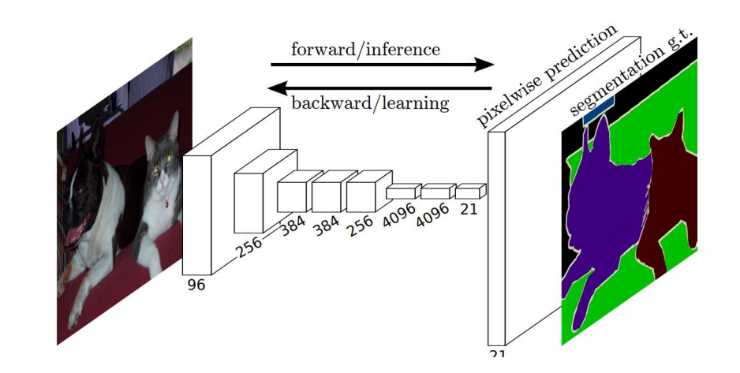
Architecture - Instance Segmentation
Mask Head : The Mask head in Mask RCNN is responsible for generating segmentation masks for each detected object instance. After ROI Align, feature maps are used separately for segmentation.
Convolution Layers: These features are passed through a series of convolutional layers. These layers help in learning spatial patterns and features relevant to segmentation.
Up-sampling layers: The output of convolutional layers is up-sampled to match the size of the origin ROI. Up-sampling helps in increasing the resolution of the features, allowing for finer details to be captured in the mask.
Binary Mask Prediction: Finally, the up- sampled features are passed through convolutional layer with sigmoid activation function. This produces a binary mask for each ROI, where every pixel value represents the probability of that pixel belonging to the object.

Slide 28
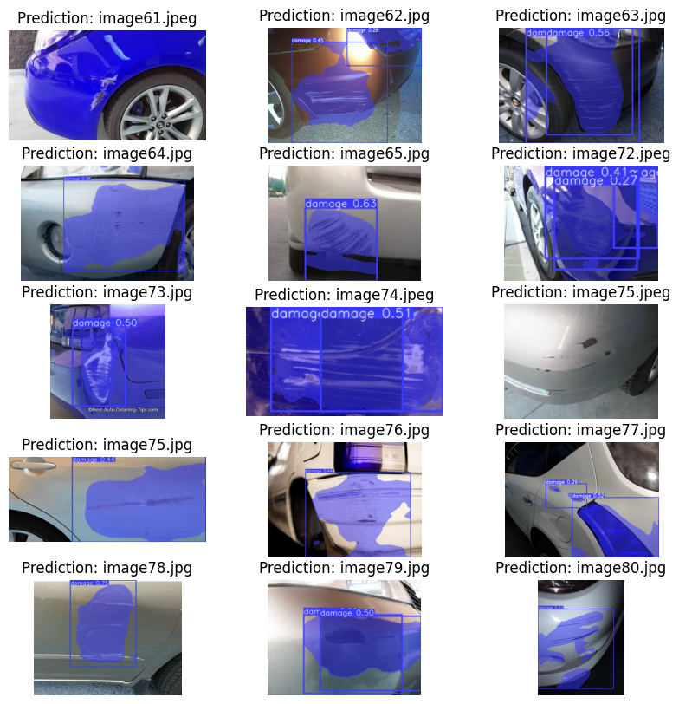
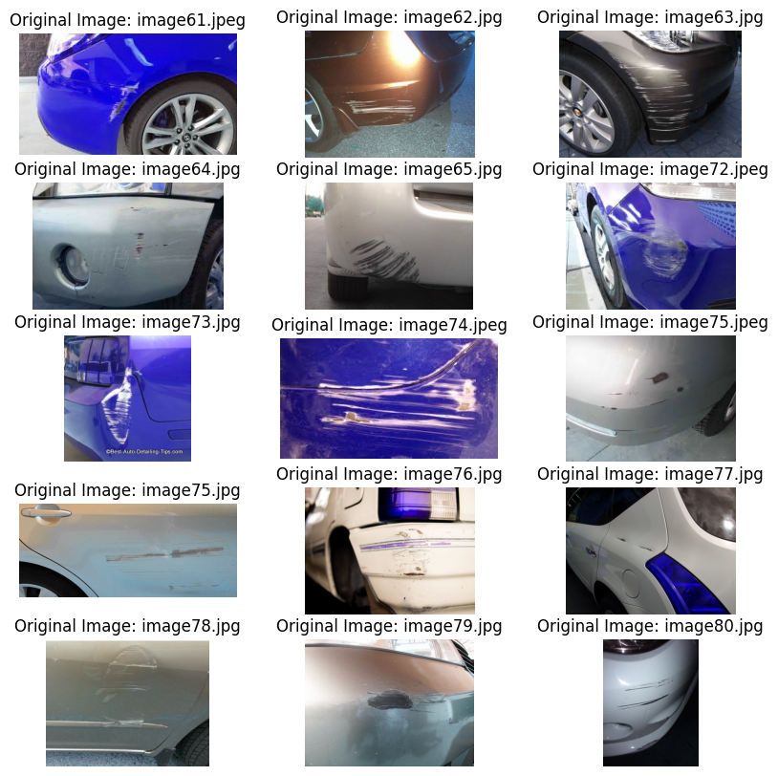
Model Results – Mask RCNN

Slide 29
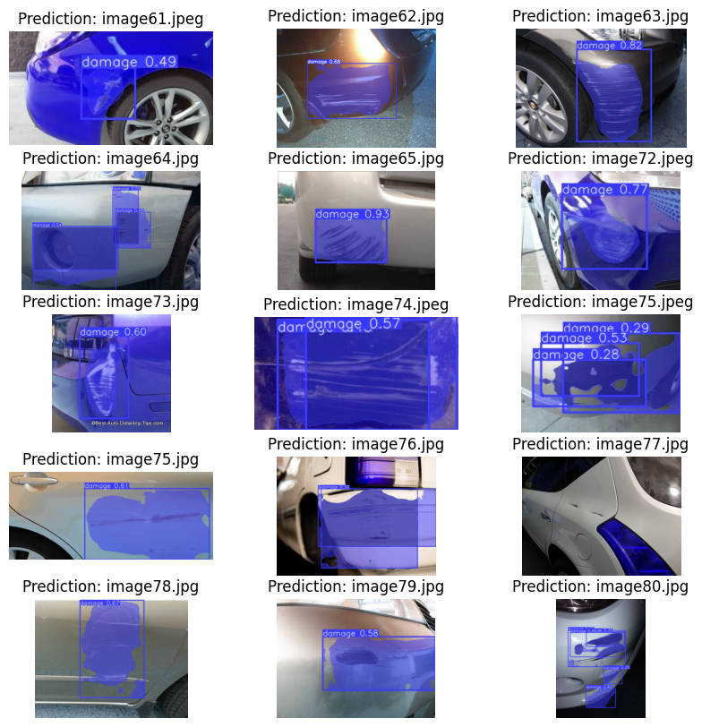
Model Results – YOLO (Transfer Learning)

Slide 30
Major Challenges & Future Scope
This model can further be utilized to detect car damages using live video feed. Current Challenge: Limited computation available
Model can be trained on more images, conditions and epochs for better results. Current Challenge: Limited Data available (with annotations)

Slide 31
Thank You

